Slide 1
LITERATURE SURVEY
Project Title : Gas Leakage Monitoring & Alerting System for Industries
Team Leader : Harivignesh S
Team Member 1 : Ezhilarasan M
Team Member 2 : Abishiek A
Team Member 3 : Gokulchandru S

Slide 2
PROJECT DESCRIPTION
There have been many incidents like explosions and fire to gas leakage. Such incidents can cause dangerous effects if the leakage is not detected at an early stage. Arduino and IOT based gas leakage detection system is a project which will help in determining gas leakage in the surroundings and send data to an IOT module.
Internet of Things (IoT) is the networking of 'things' by which physical things can communicate with the help of sensors, electronics, software, and connectivity. These systems do not require any human interaction and the same is the case with iot based gas monitoring system, it does not require human attention.

Slide 3
FEATURES
This project helps the industries in monitoring the emission of harmful gases.
In several areas, the gas sensors will be integrated to monitor the gas leakage.
If in any area gas leakage is detected the admins will be notified along with the location.
In the web application, admins can view the sensor parameters.

Slide 4
EXISTING SYSTEM
Sensors, microcontrollers, relays, LCD display and buzzer are the material used for gas leak.
It is used to convert power supply system area from alternative current to direct current.
Mq 5 sensor: This sensor is constructed by micro AL203 ceramic pipe and contains SnO2 (Tin Dioxide) layer, capable of measuring electrode and the heater is covered by plastic and stainless steel.
Arduino: An Arduino is a microcontroller, whose main goal is to make electronic to be as easy as possible. It is provides Integrated Development Environment (IDE). Arduino contains several numbers of parts and integrated interfaces in a particular circuit board.
LCD display: The LCD (liquid crystal display) contains two interfaces on upper and lower side of the module. The 16x2 LCD display has the height and width size of 80.0 x 36.0 mm and containing VA size of 66.0 x 16.0 mm and thickness of LCD 13.2 mm. operating power supply ranges from +5.0 V or +3.0 V.

Slide 5
EXISTING SYSTEM
Load cell: A Load cell is a transducer is used to convert power into electronic output . It is used to detect the weight of the cylinder in this proposed system and is organized Interface with Microcontroller. The weight of the strain gauge load cell dominates the industry. Where it is used precisely in mechanical places expect on certain places laboratories
Wifi modem: WiFi modem can easily establish a connection through a serving WiFi adapter. It is easily accessible by microcontroller due to its simple connection through UART (Universal Asynchronous Receiver/Transmitter) Interface.
Buzzer: A buzzer is an audio signaling device which is capable of controlling microcontrollers IO via, with the working voltage of 5V.22. If the LPG sensor detects a gas leak at workplace or at home, the sensor will detect the noise and the gas leak will stop.

Slide 6
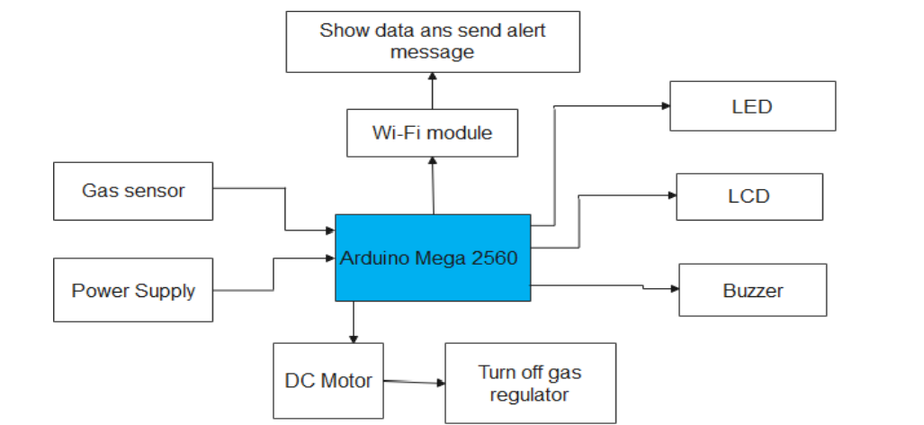
PARADIGM OF EXISTING SYSTEM

Slide 7
PREDICTED SYSTEM
Predicted work suggests that to ensure gas leakage detection.
Our project work must ensure gas leakage detection, Gas flow control, sudden SMS regarding leakage.
Checking the gas leakage and sends the notification to user.
Using sensors in various areas to monitor the gas leakage.
Sudden SMS regarding leakage is necessary.
Ensuring constant gas flow.

Slide 8
CONCLUSION
The main aim behind this project is to prevent the leakage of harmful gases. Gas leaks not only pollute the environment but also dissipate gases, damaging our economy. This system will help if such a situation arises. We can avoid dangerous accidents caused by gas leakage in industries with the help of gas leakage monitoring and alerting system

